Slide 1

MALIGNANT COMMENT CLASSIFICATION
SUBMITTED BY-: IMRAN AHMAD

Slide 2
INTRODUCTION
People use social media as a platform to express their opinions and views.
They do this freely and without any reluctance.
With it comes the risk of cyber abuse and harassment, which can put an end to people expressing themselves and giving up on seeking opinions.
To protect the users from cyberbullying, every organization should have an automated system in place to identify such malicious comments and suitable actions against the same.

Slide 3

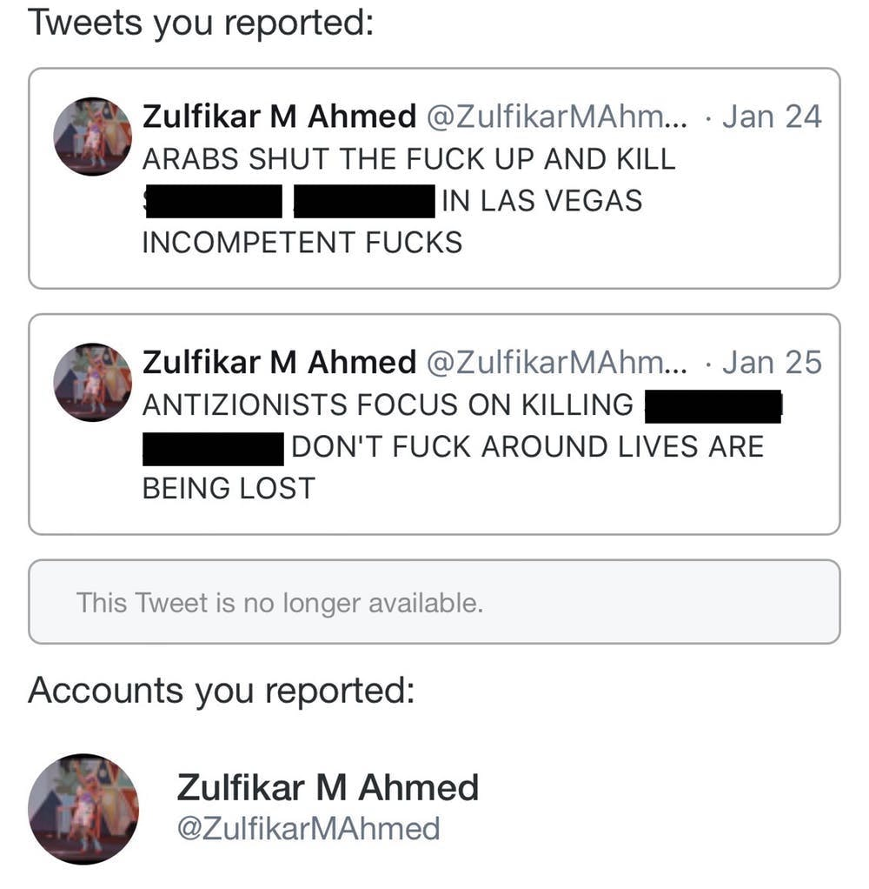
OBJECTIVE
We have undertaken this project to classify the comments made by different users on social media platforms, like the tweets from Twitter in this case, to build a model that is capable of detecting and classifying these tweets into various classes like threat, obscene, insult and identity-based hate.

Slide 4

DATA EXTRACTION
We started out by using the Twitter API, in Python to extract the tweets from Twitter.
We collected the tweets containing cuss words using the track parameter to gather relevant data to perform our analysis.
We saved the data gathered from Twitter in a CSV file.

Slide 5
DATA EXTRACTION
Geography
country
Count
followers_count
Date and Time
dateTime
country_code
quote_count
reply_count
retweet_count
favorite_count

Slide 6
DATA EXTRACTION
META DATA
tweetID
Tweet
tweet
screen_name
full_name
name
source

Slide 7

PREPROCESSING OF THE DATA
We have performed the following preprocessing on the data:
Removed punctuations
Removed the stop words
Stemming and lemmatization
Applied counter vectorizer

Slide 8
DATA MODELLING
Problem Transformation Method
We used the Multinomial Naïve Bayes classifier for classification.
We used this classifier, since it is suitable for classification with discrete features.
The algorithm estimates the conditional probability of a particular word given a class as the relative frequency of term t in documents belonging to class(c).
The variation takes into account the number of occurrences of term t in training documents from class (c),including multiple occurrences.

Slide 9
DATA MODELLING
Adaptation Algorithms
We used the Backpropagation for Multilabel Learning algorithm.
The BPMLL algorithm is a back-propagation neural network algorithm adapted for multi-label classification by having multiple binary outputs as the label variables.
It helped to classify the tweets in real-time as the algorithm changes its behavior at the time it is run, based on information available and on a priori defined criterion.

Slide 10
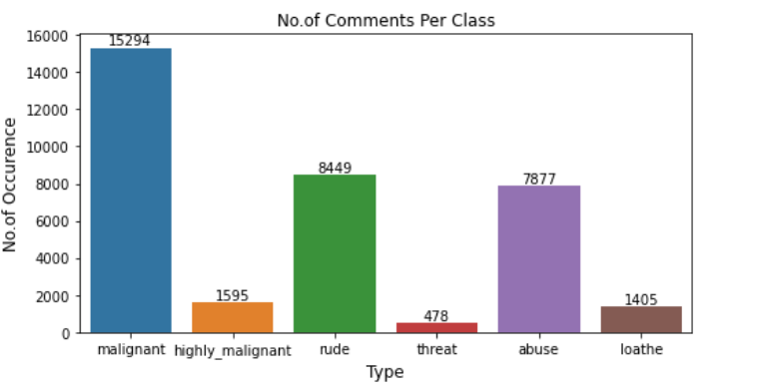
DATA VISUALIZATIONS

Slide 11
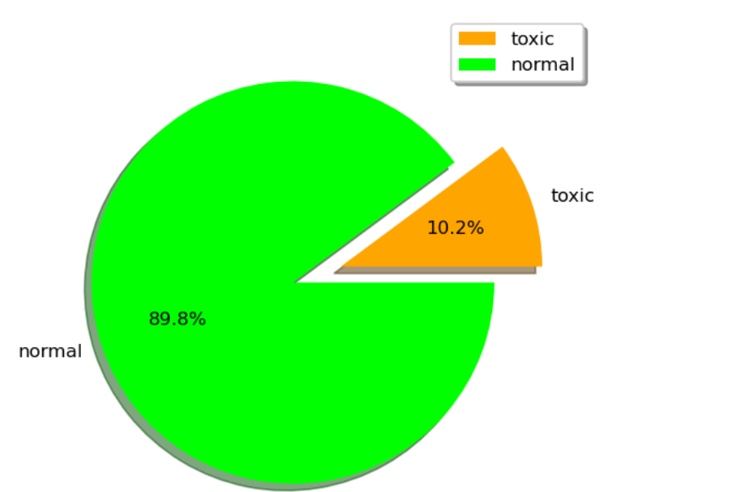
DATA VISUALIZATIONS

Slide 12

ANALYSIS OF RESULTS
Upon testing the models, on the malignant tweets we have analyzed the following:
Most of the tweets are up to 200 characters long.
Most of the tweets fell under the “toxic” class.

Slide 13
CHALLENGES
Multiple labels – For Binary classification we have many models available but for multilabel classification the selection of models decreases drastically.
Collection of USABLE DATA – although we extracted over 100000 records, only 14000 records were usable among them.
Cleaning the data – Due to the character limit tweets contain a lot of short forms which are different to classify using bag of words model.
TWITTER RATE LIMIT – Due to the twitter rate limit we were getting timed out every 15 mins due to which the data collection process took over 8 hours.

Slide 14
FUTURE SCOPE
The current project predicts the type or toxicity in the comment.
We are planning to add the following features in the future:
Analyze which age group is being toxic towards a particular group or brand.
Add feature to automatically sensitize words which are classified as toxic.
Automatically send alerts to the concerned authority if threats are classified as severe.
Build a feedback loop to further increase the efficiency of the model.
Handle mistakes and short forms of words to get better accuracy of the result.

Slide 15
REFERENCES
https://en.wikipedia.org/wiki/Multi-label_classification
https://www.kaggle.com/c/jigsaw-toxic-comment-classification-challenge
https://ac.els-cdn.com/
http://ceur-ws.org/Vol-1751/AICS_2016_paper_33.pdf
https://www.analyticsvidhya.com/blog/2017/08/introduction-to-multi-label-classification/
http://citeseerx.ist.psu.edu/viewdoc/download?doi=10.1.1.507.910&rep=rep1&type=pdf
https://dzubo.github.io/machine- learning/2017/05/25/increasing-model-accuracy-by-tuning-parameters.html

Slide 16
THANK YOU

